Slide 1
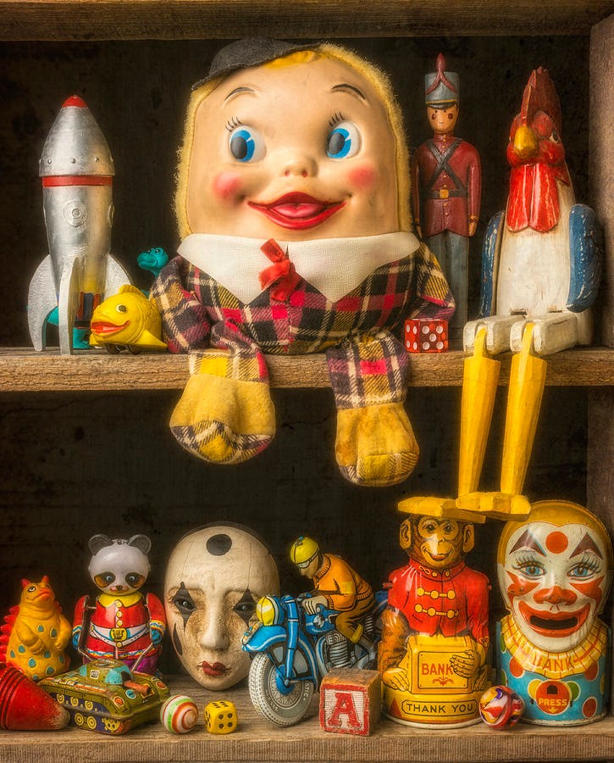
Year 1 A TOY STORY
How have toys changed over time?
Writing
Non fiction
Story retelling
Character description
AUTUMN TERM 2
Science
Properties of materials
English
Read Write Inc
Author Spotlight: Sue Hendra
PE
Parachute games
Dance
History
How have toys changed over time?
Maths
Subtraction within 10, Addition within 10, fact families
2D and 3D shapes
Music
Christmas Performance
RE
Why is giving important?
Cross Faith
Art
Fabric landscapes Artist: Alexandra Kehayoglou
PSHE
Health and Well-being
PSHE
Living in the wider world
PSHE
Relationships

